Slide 1

Basic Details of the Team and Problem Statement
Ministry/Organization Name/Student Innovation: Ministry of Jal Shakti/Central Ground Water Board (CGWB)/
PS Code: SIH1696
PS Title: Software Application - Ground Water Level Predictor
Team Name: The Yodhas
Team Leader Name: Pradip Sah Sonar
Institute Code (AISHE):
Institute Name: Amrita Vishwa Vidhyapeetham, Chennai
Theme Name: Smart Automation

Slide 2

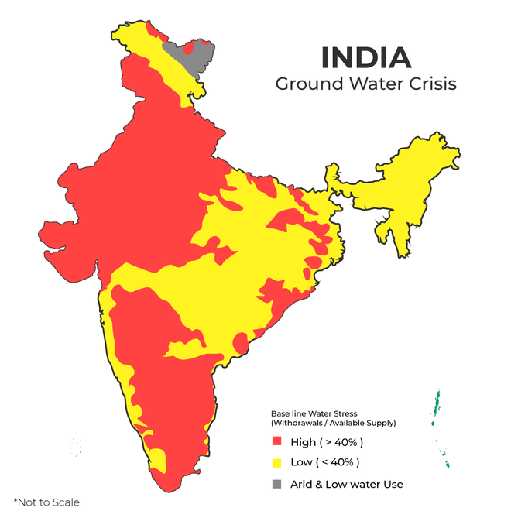

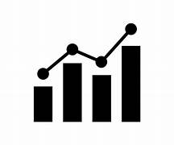
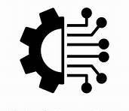
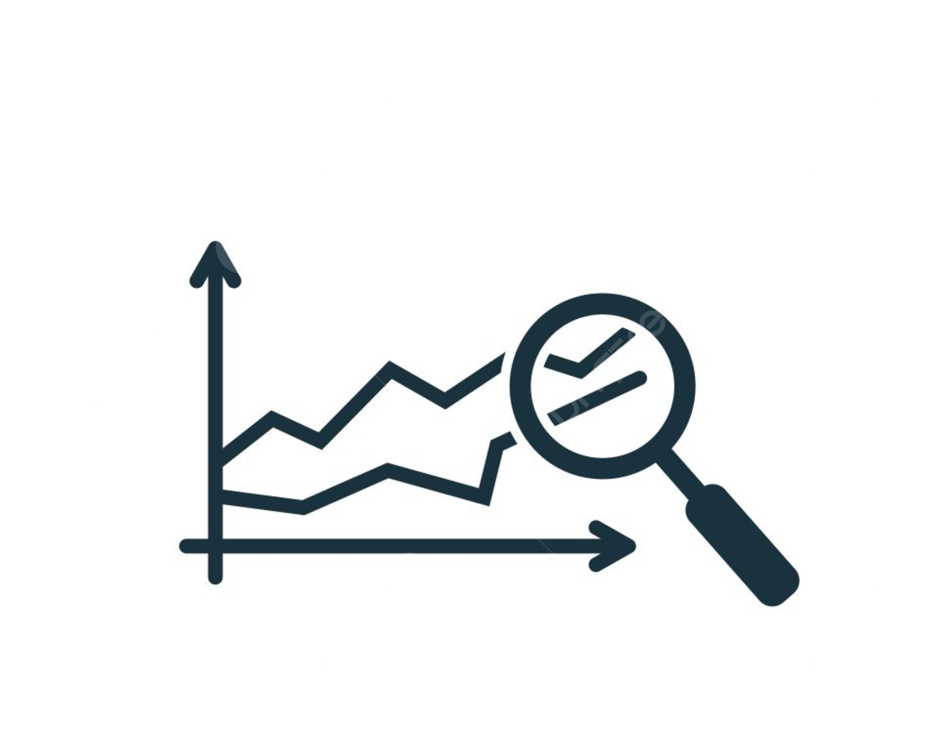
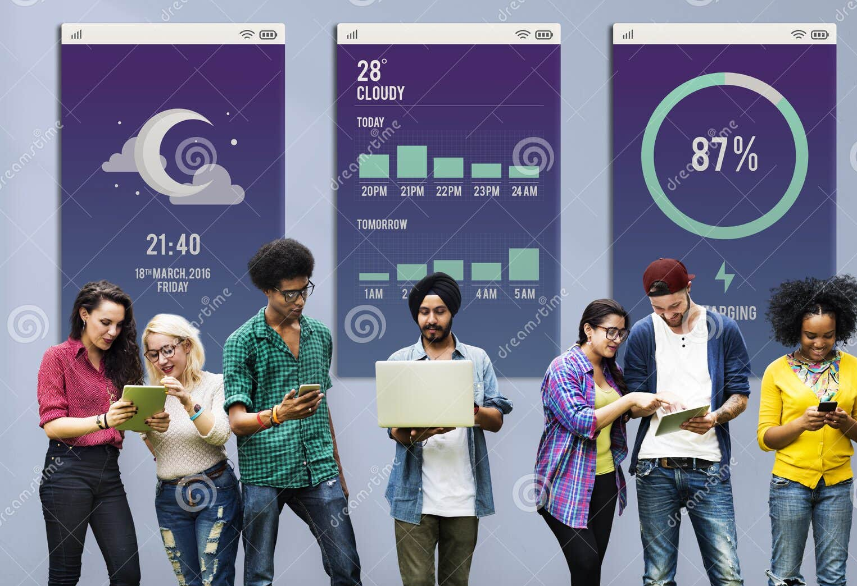
OUR IDEA: IndiaGWanalytics
IndiaGWanalytics is a website designed to provide a comprehensive view of groundwater scenarios across India. It utilizes GIS mapping and advanced analysis tools to visualize groundwater levels and trends.
KEY FEATURES:
Interactive Maps
Dynamic Graphs
Data Integration(CGWB)
Predictive Analytics
User-Friendly Interface

Slide 3
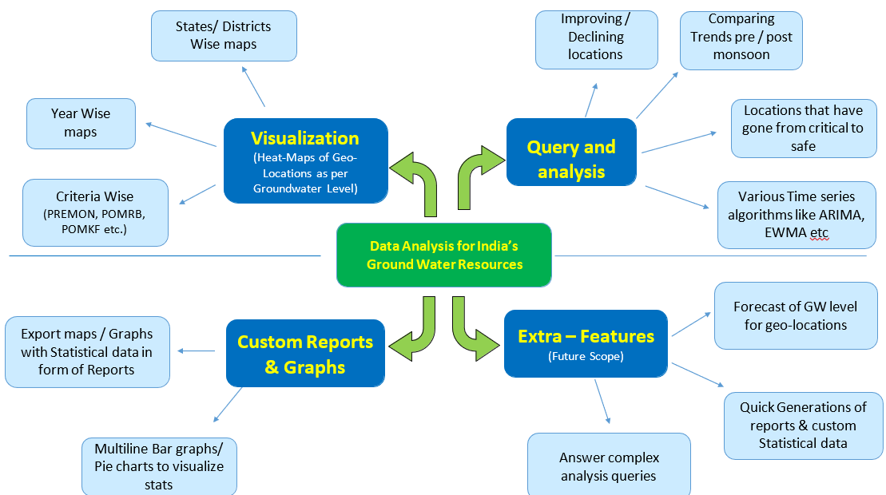
OUR SOLUTION: ARCHITECTURE DIAGRAM

Slide 4
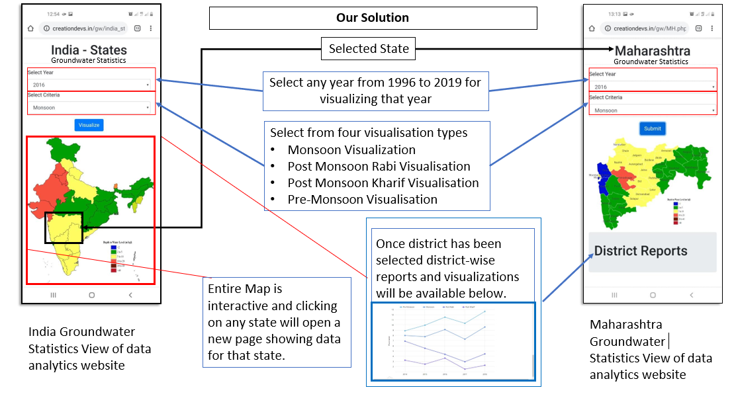
IndiaGWAnalytics: PROCESS FLOWCHART

Slide 5
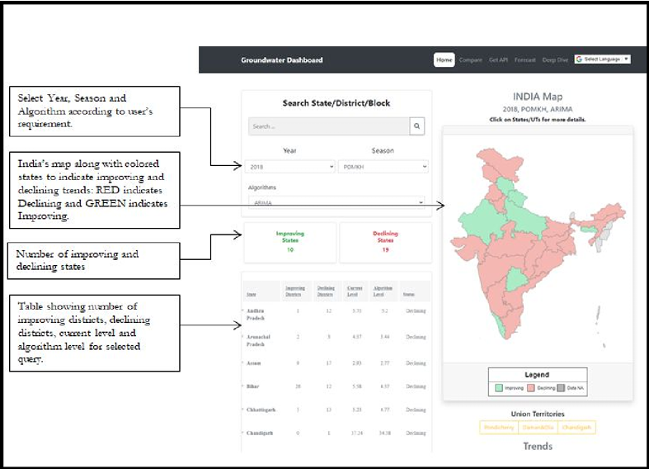
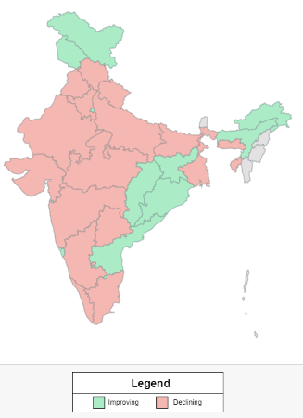
IndiaGWAnalytics: WEBSITE OVERVIEW
In this section, a brief overview of the website has been provided for the user’s understanding and navigation. The Dashboard provided by the website gives the user an pleasant and easy-to-navigate UI which prompts the user to select the year and season to view on India’s map as the user first lands on the home page. Along with the year and season, we also provide an option to select an algorithm according to which the visualization will be done.
Select your season and Algorithm according to user’s requirement
India’s map along with colored states to indicate improving and declining trends: RED is declining and GREEN is improving
Number of improving and declining states
Table showing no of districts, declining districts, current level for selected query

Slide 6
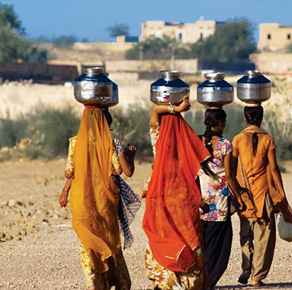
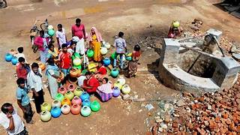
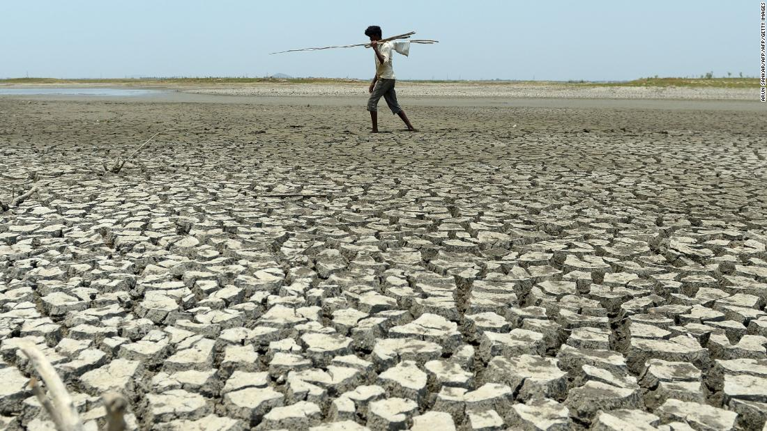
Ground-Water crisis in India
India Groundwater Statistics
•More than 50% of Indian districts and cities are facing water supply problems for years.
•In many parts of country groundwater table is declining at the rate of 1-2 m/year.
•21 cities predicted to run out of groundwater in 2020 (including Bengaluru, Delhi, Chennai)
•Atal Bhujal Yojana worth 6000 crore launched for preserving regions with low water table.
If this trend continues India will undergo a major water crisis and would lead to irreversible losses.

Slide 7
STACK TECHNOLOGY
Frontend (User Interface/ website):
3. Backend( Analysis):
•HTML/CSS
•JavaScript
•Php
•Frameworks
1. React.js
2. OpenLayers
3. D3.jS
•Node.js
•Python
HTML/CSS
JavaScript
php
Frameworks
React.js
OpenLayers
D3.jS
4. Analytics and Machine Learning
•Scikit-learn
• Statsmodels
5. GIS and Data Visualization
Google Maps API
Matplotlib
• Google Maps API
• Matplotlib
2. SQL Database

Slide 8
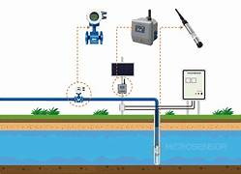
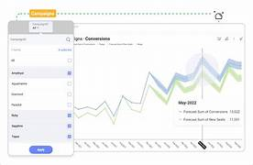
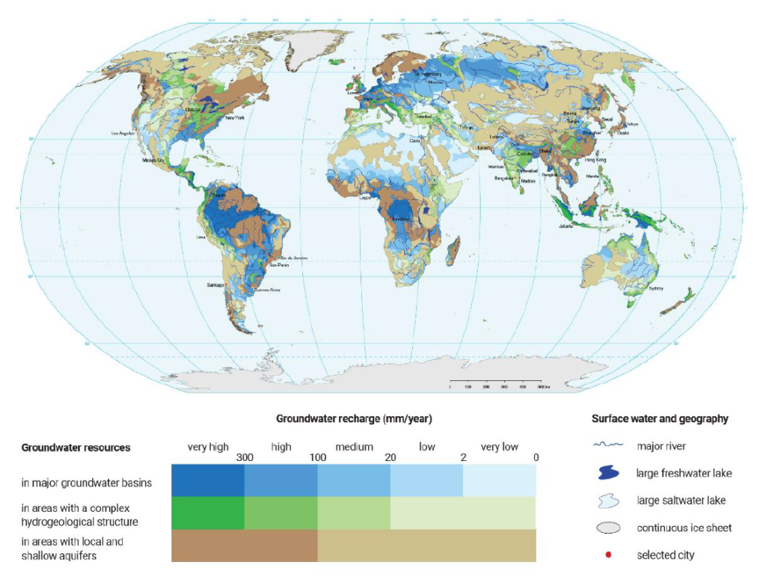
Here are some potential (Use Cases) of our platform:
Use Case 1: Groundwater Monitoring and Visualization
Use Case 1: Groundwater Monitoring and Visualization
Researchers, policymakers, environmental agencies, local authorities.
Researchers, policymakers, environmental agencies, local authorities.
Use Case 2: Predictive Groundwater Analytics
Use Case 2: Predictive Groundwater Analytics
Researchers, state water departments, farmers.
Researchers, state water departments, farmers.
Use Case 3: Report Generation for Groundwater Evaluation
Government agencies, industrial bodies, policy analysts.
Use Case 3: Report Generation for Groundwater Evaluation
Government agencies, industrial bodies, policy analysts.

Slide 9
Dependencies/Show Stopper
Show stopper :
Data Gaps:
High Costs of GIS Tools and Hosting:
Internet Accessibility:
Regulatory Barriers:
Future Scope
Forecasting: Forecasting can be done by various methods such as ARIMA, exponential moving averages, Recurrent Neural Networks ,LSTM’s using this data as well we can predict future progressing & declining villages to do damage control in advance.
Answer to complex GIS queries such as:
Which districts in Maharashtra (say) consumed more than natural groundwater recharge?
Show general trend of groundwater table height in India.
Such queries give the application more value and help in gaining a better perspective on the groundwater situation of the country.
Dependencies:
Data Availability:
Rainfall, Land Use, Population Data: Access to accurate environmental and demographic data is needed for predictive analytics.
Technology Stack:
GIS Integration: Successful integration of GIS mapping tools (e.g., Leaflet, OpenLayers) with backend services for real-time data visualization.
Skilled Workforce:
Requires a skilled team for implementing GIS mapping, data analytics, machine learning models, and web development. This includes experts in hydrogeology, data science, and software engineering

Slide 10
Team Member Details
Team Leader Name: Pradip Sah Sonar
Branch : Btech Stream : CSE Year : II
Team Member 1 Name: Aniket Singh
Branch : Btech Stream : CSE Year : II
Team Member 2 Name: Bhanu Pandit
Branch : Btech Stream : CSE Year : II
Team Member 3 Name: Komal Chaurasiya
Branch : Btech Stream : CSE Year : II
Team Member 4 Name: Binay Kushwaha
Branch : Btech Stream : CSE Year : II
Team Member 5 Name: Type Your Name Here
Branch : Btech Stream : CSE Year : II
Team Mentor 1 Name: Type Your Name Here
Category (Academic/Industry): Expertise : Networking Domain Experience : 3-4 yrs

Slide 11
THANK YOU!!

